Slide 1

Predicting Customer Churn
THE SAPPHIRE BANK
Ishika Bhutani
301323447

Slide 2

Agenda
Overview
Objective and Approach
Analysis
Modelling Techniques
Next Steps and Recommendations

Slide 3




Overview
1
2
3
4
Churn
Analysis
Modelling
Outcome
Loss of customers, revenue and increased cost of acquisition
Predictive model identifies at-risk customers
Models have been assessed on accuracy, ROC-AUC and F1 score
Strategies for proactive customer retention and long-term loyalty.

Slide 4

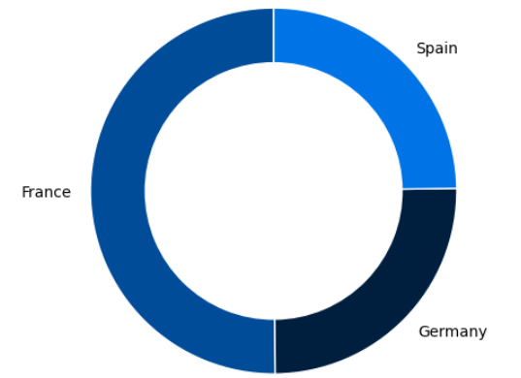


Business Objective
Predict to Protect: Targeted insights to retain Sapphire Bank’s most valued customers and safeguard revenue.
Data Analysis and Preparation
16%
Cleaning, Pre-processing and Analyzing
Model Development and Evaluation
32%
The most effective model is selected according to the metrics
Recommendations
16%
Strategic recommendations to reduce churn

Slide 5
Data Introduction
Dropped Variables
Categorical Variables
Number | Variable | Meaning
1 | RowNumber | Row number
2 | CustomerId | ID of Customer
3 | Surname | Last Name
4 | CreditScore | Customer’s credit score
5 | Geography | Country where customer lives in
6 | Gender | Gender of Customer
7 | Age | The age of customer
Number | Variable | Meaning
8 | Tenure | Number of years customer has been with the bank
9 | Balance | Account balance
10 | NumOfProd | Number of products that customer uses
11 | HasCrCard | Whether or not a customer has a credit card
12 | IsActiveMember | Whether or not a customer is an active member
13 | EstimatedSalary | The estimated salary of the customer
14 | Exited | Whether the customer has churned or not

Slide 6
Modelling Approach
Exploration for patterns, outliers, relationship
Visualizations
- Logistic Regression -Decision Tree
Random Forest
- Gradient Boosting
Data Prep
EDA
FEATURE ENGINEERING
MODEL
EVALUATION
-Excluding unique identifiers
-Encoding Categorical Variables
-Normalizing Numerical Features
-Defining the features
-Target Variable
-Splitting the dataset
Key metrics: ROC-AUC, F1 Score, Accuracy

Slide 7
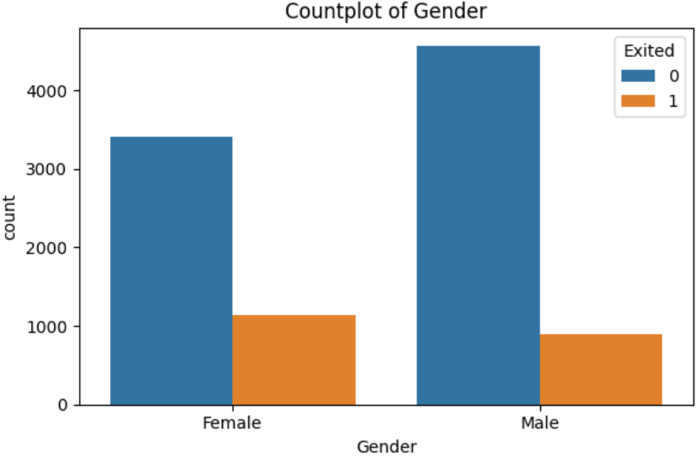
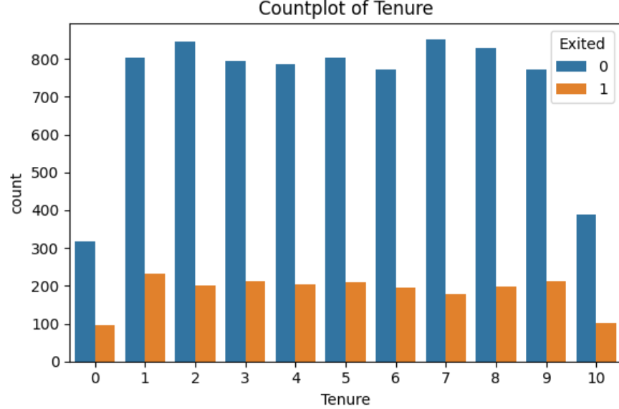
Exploring Data Patterns
Plot of Gender
The count of female customers is lower than male customers, but the proportion of exits is higher.
More male customers overall, with a lower proportion exiting compared to females.
Plot of Tenure
The distribution of tenure is fairly even, but exits are higher for customers with very short (0-1 years) and very long (9-10 years) tenures. This suggests that new customers and those with the longest relationships are more likely to churn.

Slide 8
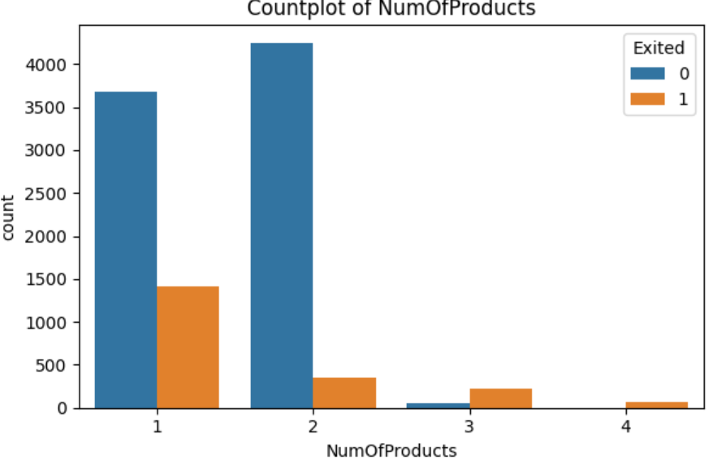
Exploring Data Patterns
Plot of NumOfProducts
The majority of the customers have only one product, with a notable number of exiting.
A smaller number of customers have two products, but the exits are also significant.
Very few customers have 3-4 products with very low exit rates indicating high engagement and lower churn.

Slide 9
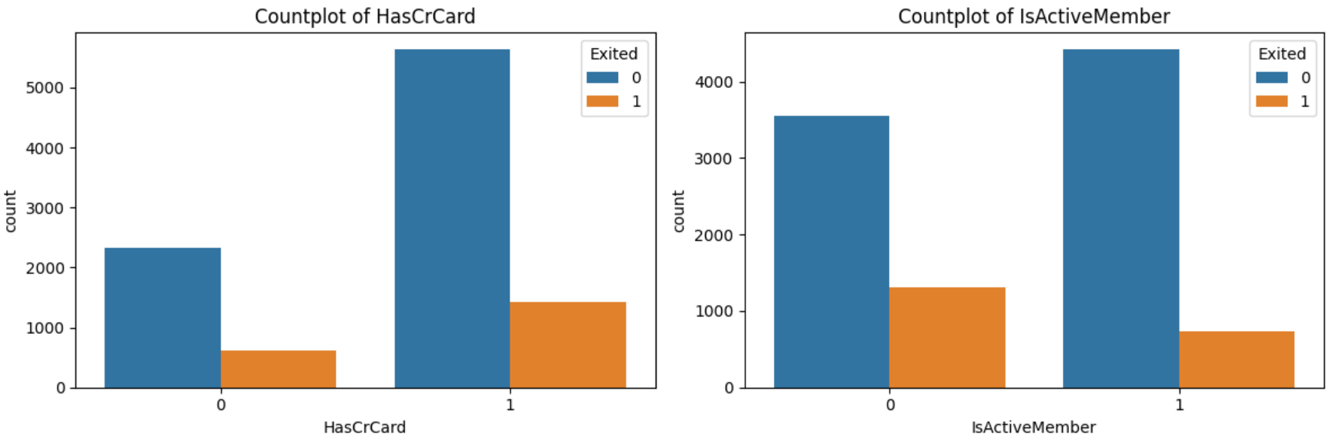
Exploring Data Patterns
Plot of HasCrCard
Plot of IsActiveMember
likelihood of a customer churn the business with the bank seems to be higher when it does not have a credit card.
Non- active members are more likely to churn than active members.

Slide 10
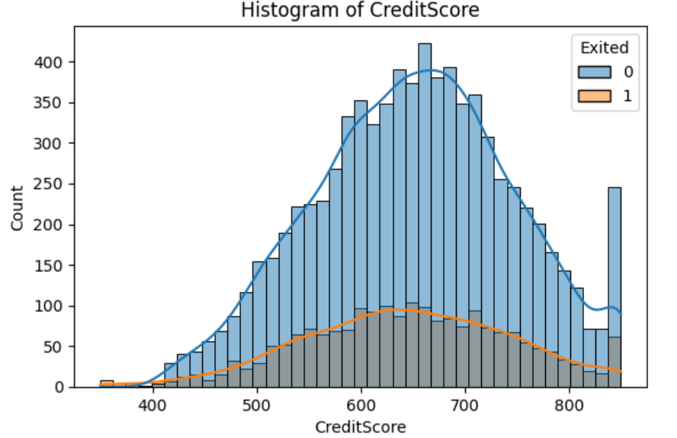
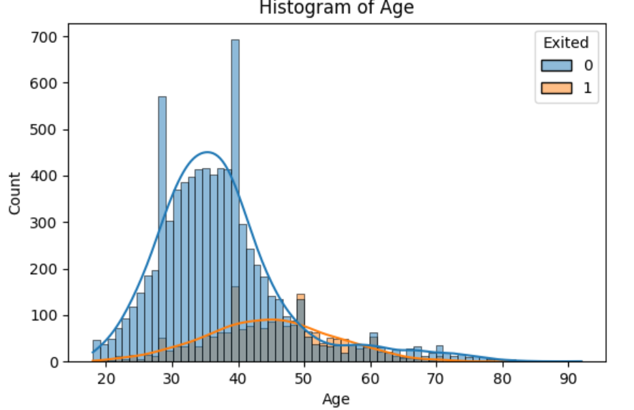
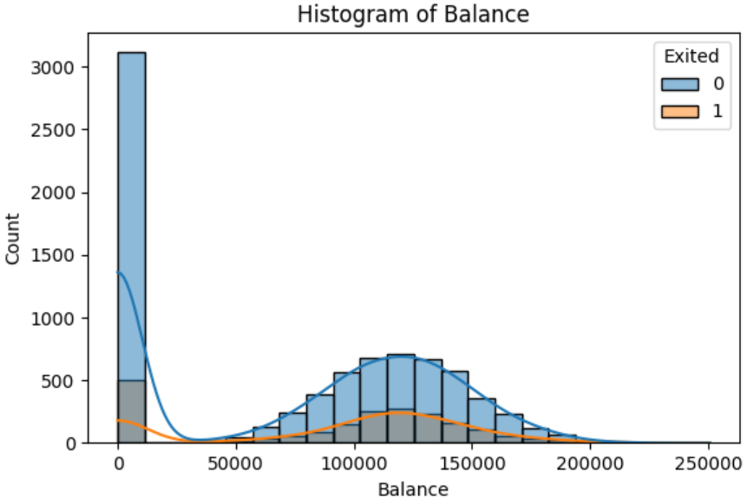
Exploring Data Patterns
Customers who have exited (Exited = 1) generally have lower credit scores compared to those who have not exited (Exited = 0).
The age distribution peaks around 30-40 years. A significant proportion of customers who exited are older (above 50 years), suggesting age might influence churn.
Many customers have a balance close to zero. Customers with higher balances (above 100,000) are more likely to have exited.

Slide 11
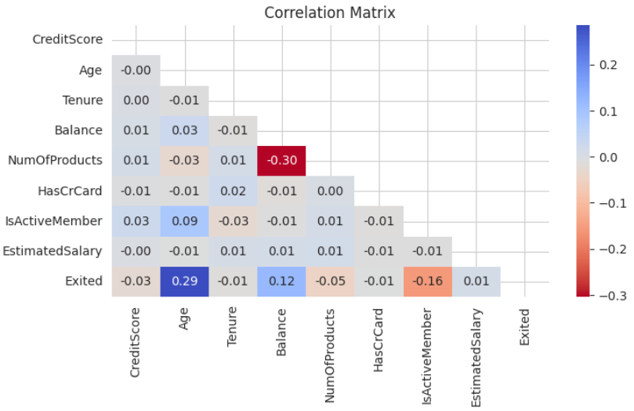
Exploring Data Patterns
Age and Exited (0.29): weak positive correlation
older customers may be slightly more likely to churn compared to younger customers.
Balance and NumOfProducts (-0.30): a moderate negative correlation
customers with more products tend to have lower account balances.
Balance and Exited (0.12): weak positive correlation
customers with higher account balances may be slightly more likely to churn.
IsActiveMember and Exited (-0.16): weak negative correlation
inactive members may be slightly more likely to churn.

Slide 12
Data Models
Logistic Regression
Random Forest
(Reduced Feature)
Decision Tree
Gradient Boosting
Random Forest
Gradient Boosting
(Reduced Feature)

Slide 13



Model Selection
Logistic Regression
F1 Score – 0.29
ROC- AUC - 0.77
81%
Decision Tree
F1 Score – 0.57
ROC- AUC – 0.83
86%
Random Forest
F1 Score – 0.58
ROC- AUC – 0.85
91%
Gradient Boosting
F1 Score – 0.58
ROC- AUC – 0.85
87%

Slide 14
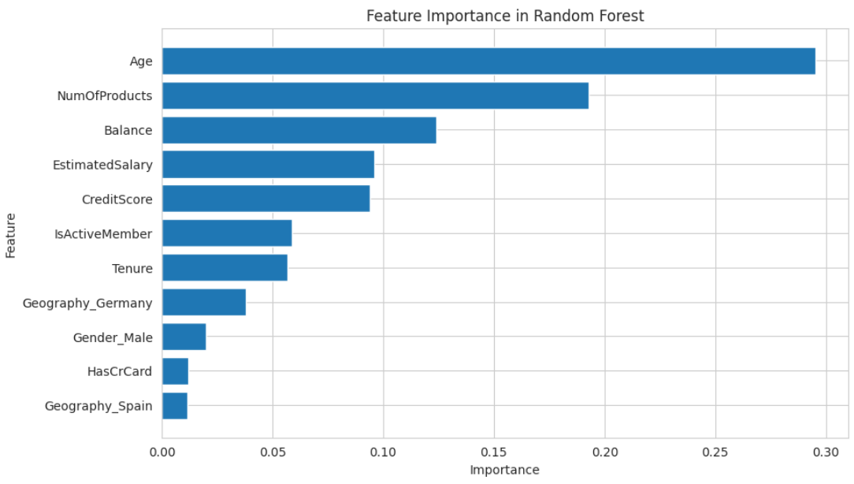
Model Insights
0.29
0.19
0.12
0.09
0.09
0.058
0.056
0.03
0.02
0.01
0.01
Age is the most influential feature.
Number of Products is the second most important feature.
Balance also has a high importance score.
Gender_Male, Geography_Spain, and HasCrCard have the least importance.

Slide 15
Recommendations and Next Steps
Specialised products and Services
Enhanced Customer Experience
Products aimed at retaining older customers
Regular customer feedback surveys, reduce wait times
Cross-selling strategies
Regularly tracking customer metrics
Increase product holding per customer
Updating customer demographics and model
Localised strategies
Strengthen customer relationship
Focus specially on Germany
Financial education, transparent communication

Slide 16
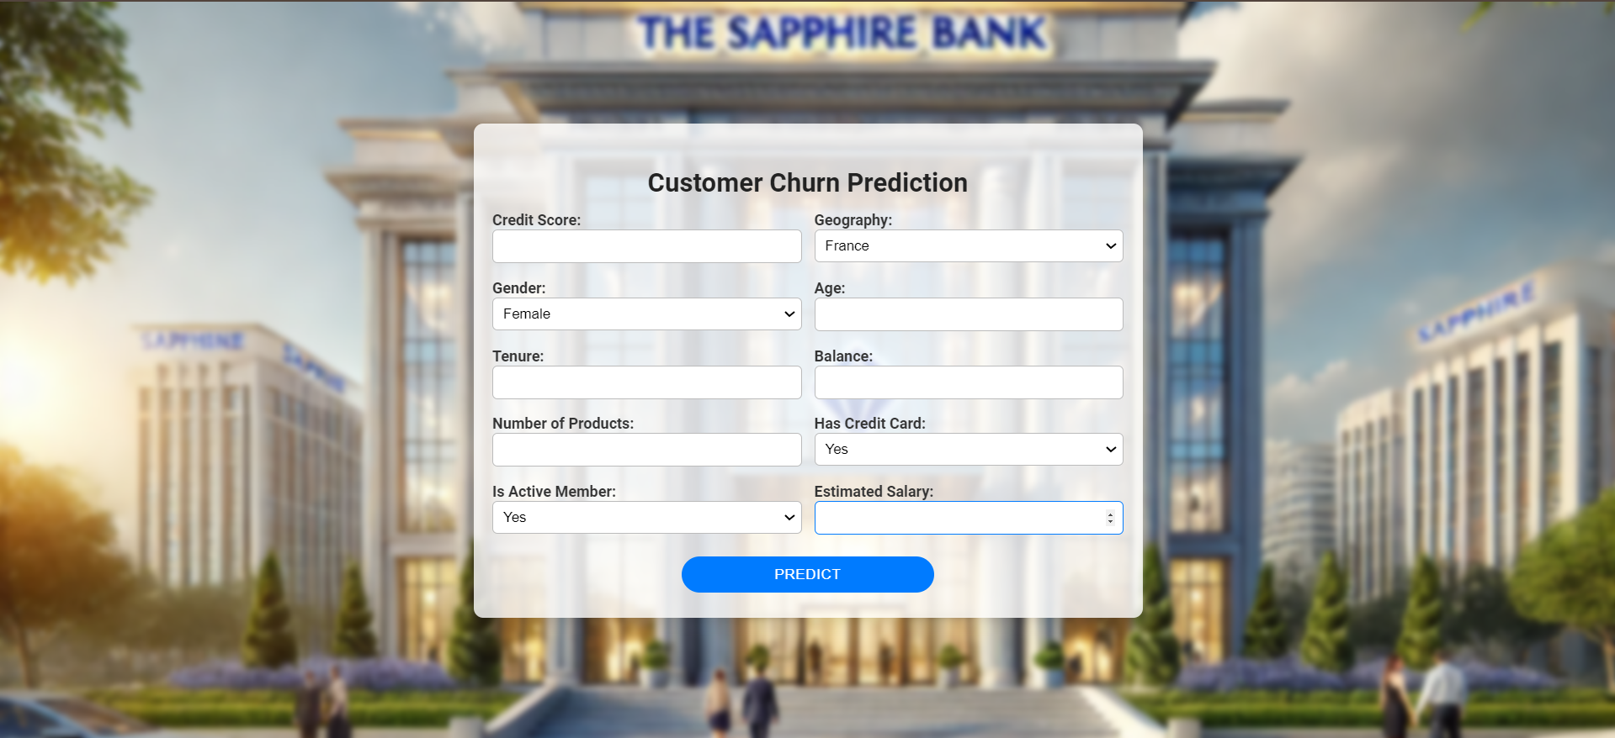
Deployment Demo
UI Link

Slide 17
References
Zangari, M. (n.d.). Customer bank churn prediction. Kaggle.
https://www.kaggle.com/code/murilozangari/customer-bank-churn-prediction

Slide 18

THANK YOU
Open to any questions

